Slide 1
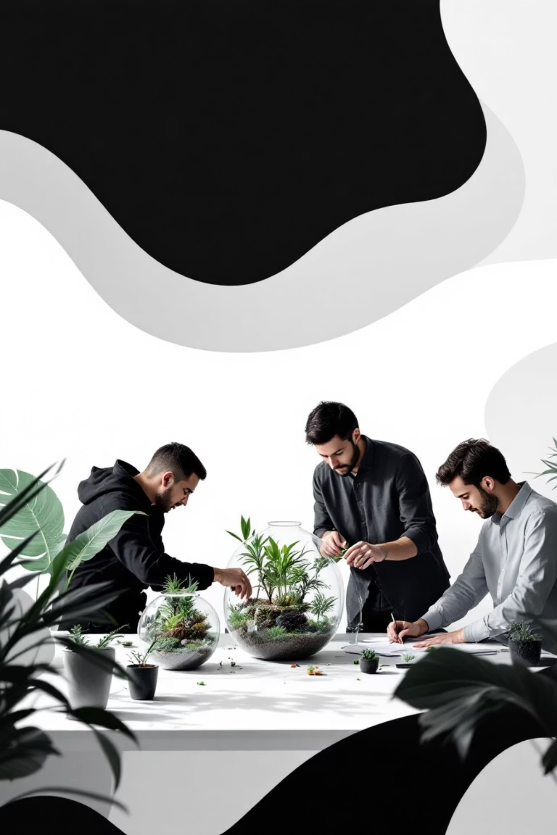


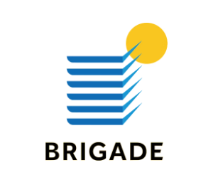
COLLABORATIVE EXCELLENCE
#CapturingEveryLeaf #ExperienceMarketing #CultureDriven
#NicheMarketing Case Study by

Slide 2
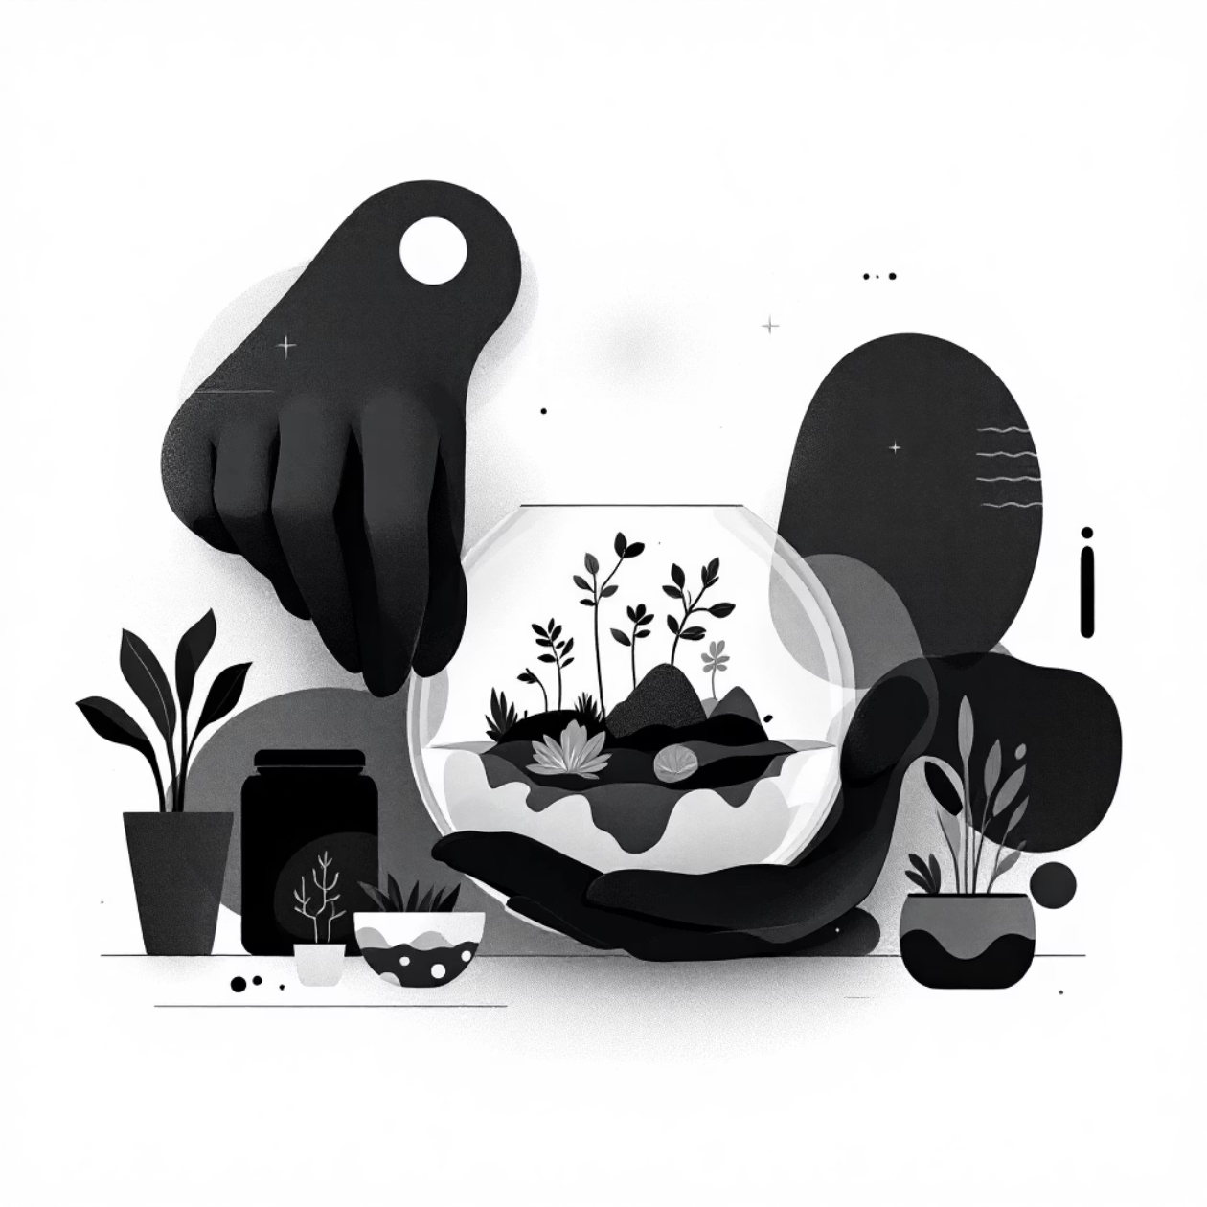
The Premise
This project tested our collaborative excellence at the intersection of three brands, crafting a vibrant terrarium workshop experience.
CrazyFlora's brand-in-a-bottle concept helps people create ecosystems within fish bowls - perfect for busy corporate employees seeking new hobbies and Instagram-worthy moments.
Our Objective: Capture this curated experience while managing people and events seamlessly.

Slide 3
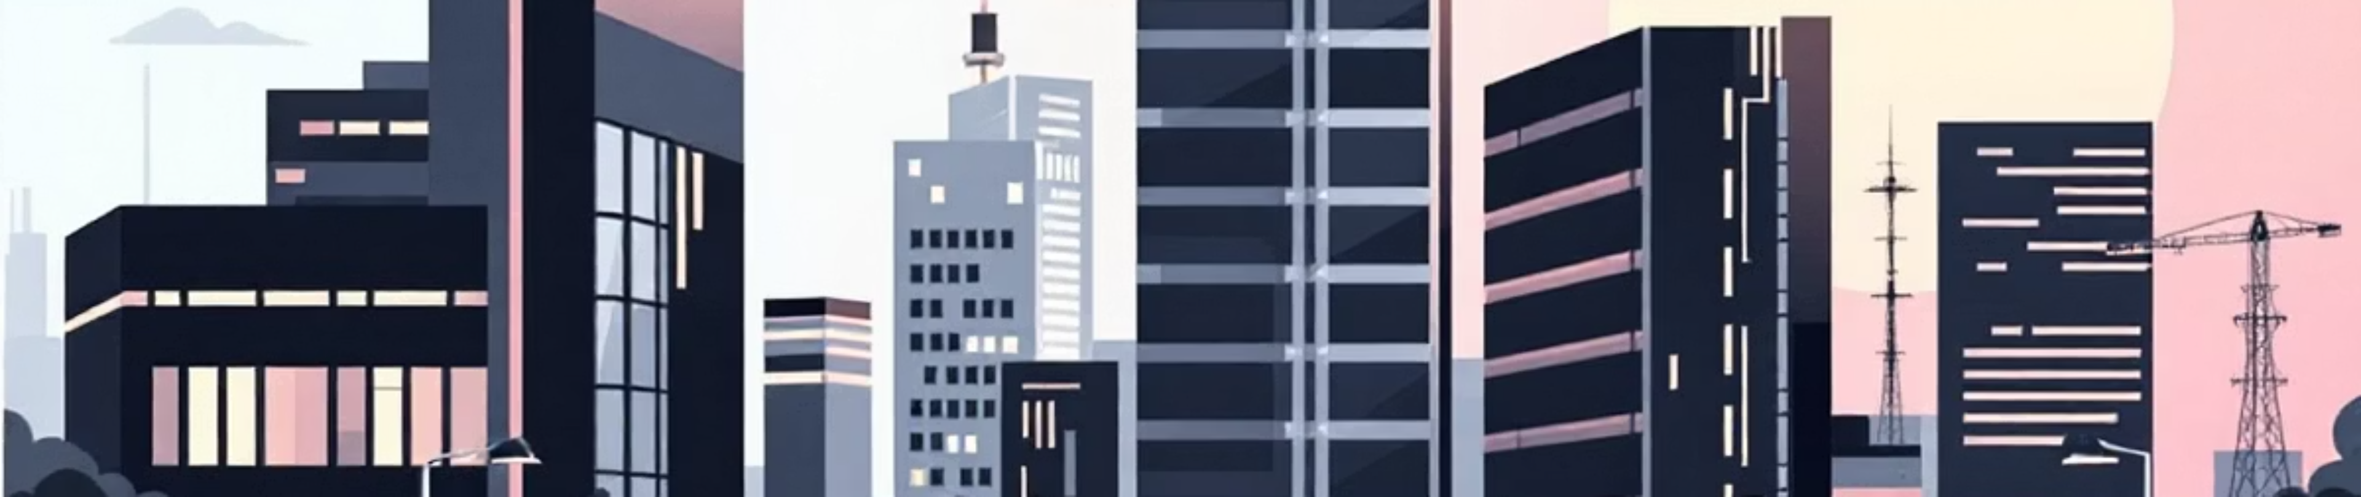
The Niche
Target Location
Audience
Demographics
4 Techparks across Bengaluru
Corporate employees in tech sector
Age 25-50, Male and Female professionals

Slide 4
The Play
We captured moments that unified 4 techparks into one continuous community engaged in terrarium creation.
Community Connection
Authentic Voices
Visual Storytelling
Conducted engaging interviews capturing genuine opinions and feedback
Documented the complete journey through 4 days of videography sessions
Showcased laughter, excitement, and focus across all workshop visuals

Slide 5
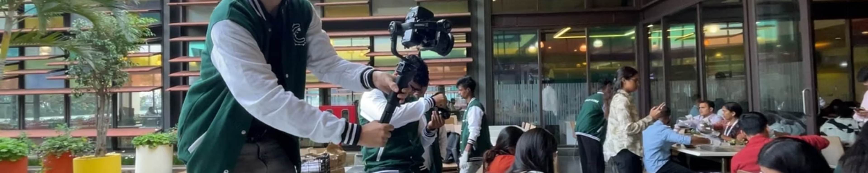
The Echo
5-10
5K+
10K+
Videos Delivered
Internal Reach
Stakeholder Impact
Professional content reaching Brigade audiences
Employees across 3 partner organizations
Extended network engagement potential
Content flexibility enables each client to adapt materials for social media and corporate communications.

Slide 6



Services Delivered
Content Strategy
Video Production
Event Management
Comprehensive planning for multi-brand collaboration and audience engagement
Complete videography and editing services across all workshop sessions
Seamless coordination of workshops across 4 Bengaluru tech parks

Slide 7
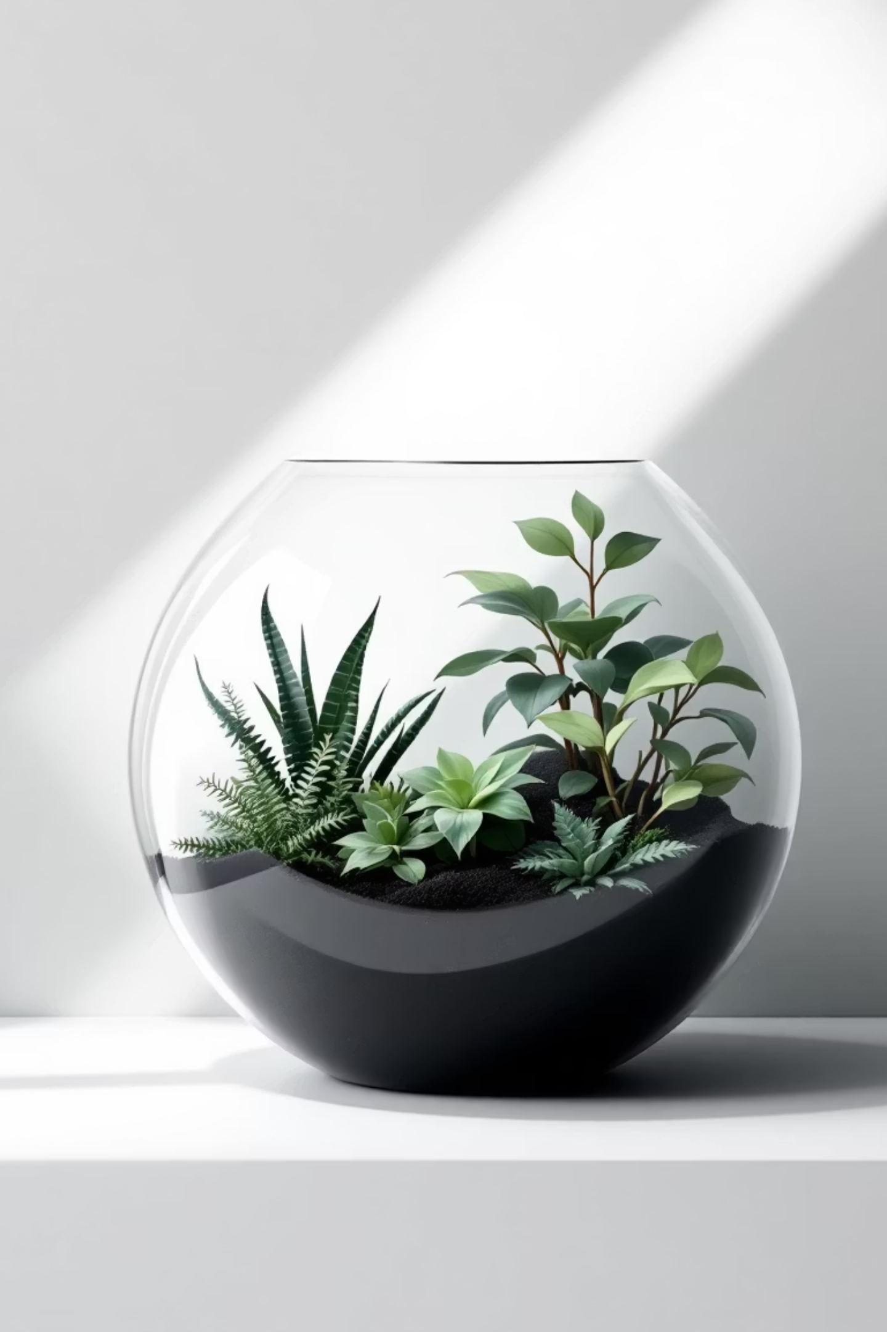
The Takeaway
This collaborative experience demonstrates our agency's flexibility and agility, working seamlessly with three organizations while meeting individual requirements.
"For CrazyFlora, this wasn't just a workshop - it was an experience so unique that they wanted to raise awareness through visually appealing content."
Four days of production delivered seamless project execution and ensured client satisfaction across all stakeholders.
Terrariums: a world within a bowl, an experience shared, and a story told.

